Slide 1
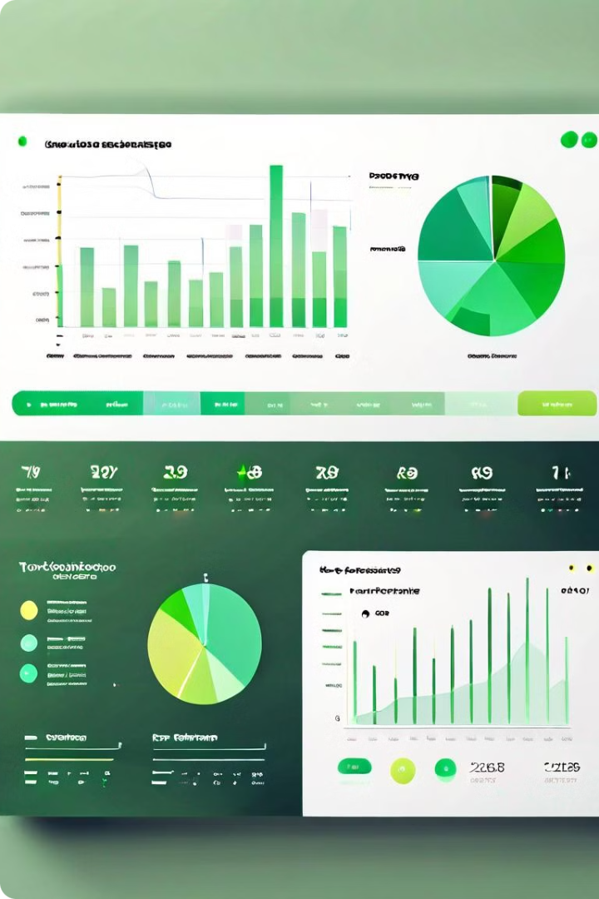
Credit Card Performance Dashboard
This presentation outlines a comprehensive credit card weekly dashboard that delivers real-time insights into key performance metrics and trends. The dashboard empowers stakeholders to effectively monitor and analyze credit card operations, enabling informed decision-making.

Slide 2

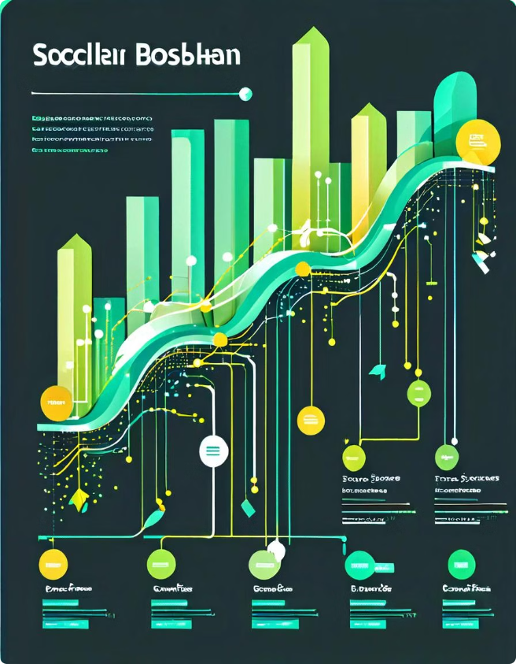
Data Import and Processing
1
SQL Database
Data is extracted from a SQL database, "ccdb", using pgAdmin4 and PL/SQL. The database contains two tables: cc_detail and cust_detail.
2
Data Transformation
New columns are added to both tables using DAX formulas. These columns group customer data based on age and income.
3
Power BI Integration
The transformed data is imported into Power BI, where it is further processed and analyzed for generating interactive dashboards.

Slide 3

Key Performance Indicators (KPIs)
1
Revenue
2
Customer Acquisition
Total revenue generated from annual fees, transaction amounts, and interest earned. This provides an overall view of financial performance.
Metrics like customer acquisition rate and churn rate help understand customer growth and retention. This is crucial for long-term sustainability.
3
Transaction Activity
4
Delinquency Rate
Analyzing transaction volume, average transaction amount, and transaction frequency helps identify trends and patterns in customer spending behavior.
Tracking the percentage of delinquent accounts helps understand the credit risk and potential for financial losses.

Slide 4

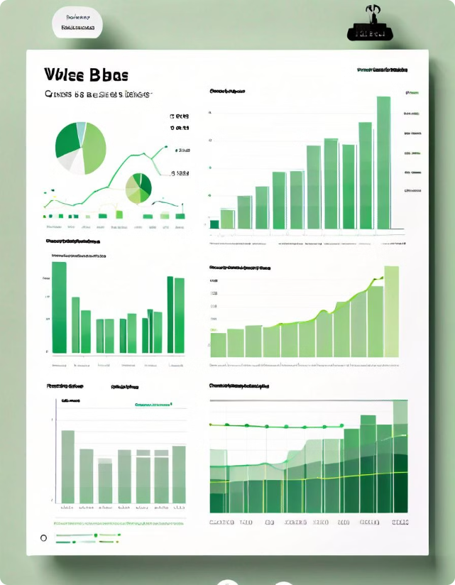
Week-on-Week (WoW) Analysis
Metric
Current Week
Previous Week
WoW Change
Revenue
$5,000,000
$4,000,000
25%
Transaction Amount
$3,500,000
$3,000,000
16.7%
Transaction Count
10,000
9,000
11.1%
Customer Count
1,500
1,400
7.1%

Slide 5
Credit Card Customer Report
Customer Segmentation
Credit Card Usage
Customer Satisfaction
Customers are segmented based on age, income, and location. This helps identify target customer groups with specific needs and preferences.
Analysis of credit card usage patterns, including spending habits, preferred merchants, and transaction frequency, helps understand customer behaviors.
Monitoring customer satisfaction levels through surveys, feedback mechanisms, and social media sentiment analysis helps identify areas for improvement and enhance customer experience.

Slide 6

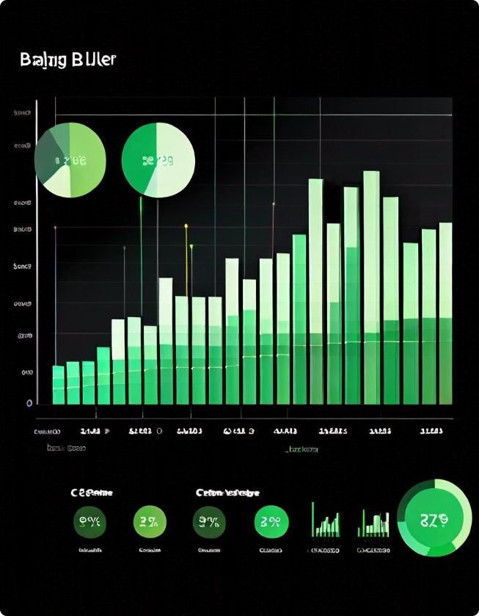



Credit Card Transaction Report
Transaction Volume
This shows the number of transactions processed each week, highlighting trends and potential spikes or dips in activity.
Transaction Value
This displays the total amount of money spent through credit card transactions, providing insights into overall spending trends.
Transaction Type Analysis
Breaking down transactions by type (e.g., online, in-store, international) provides insights into customer spending habits and preferences.

Slide 7


Key Insights & Actionable Recommendations
Customer Acquisition Focus
Focus on acquiring customers in specific demographics with high potential for spending and revenue generation, such as high-income individuals.
Targeted Marketing Campaigns
Design personalized marketing campaigns that cater to specific customer needs and preferences based on demographics, spending habits, and transaction history.
Improve Customer Service
Address customer concerns promptly and efficiently, and provide personalized assistance to enhance overall customer satisfaction and loyalty.
Fraud Prevention Strategies
Implement robust fraud detection and prevention measures to minimize financial losses and protect both customers and the business.

Slide 8

Continuous Monitoring and Improvement
Regularly review the dashboard data and monitor key performance metrics. Analyze trends and insights to identify areas for improvement, optimize credit card operations, and enhance customer experience.

